Slide 1
GSA Fleet Card Program
Brian Moseley

Slide 2
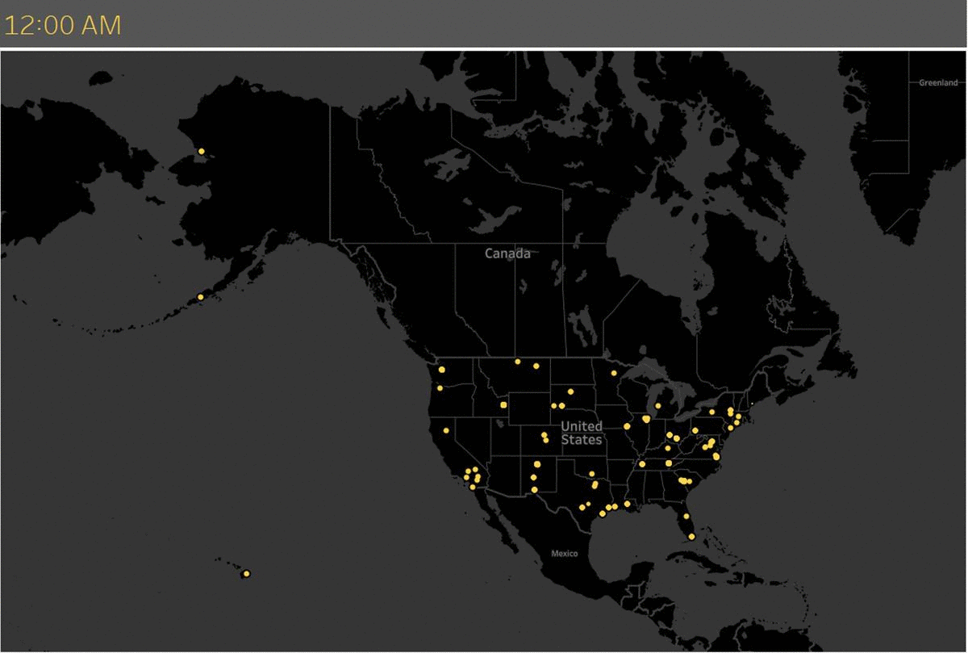
USA Map

Slide 3
Creating Connections Through Fleet Cards
Seamless Program Management
Turnkey
Driver
Experience
GSA Fleet
Helpful Rules
of the Road
Resources

Slide 4
Quote
“
Coming together is the beginning. Keeping together is progress. Working together is success.
Henry Ford

Slide 5
Saving Agencies Resources
SmartPay Contract Oversight
OMB A123 Appendix B Compliance
Loss Prevention Team
Fleet Card Audit Support
Data for Reporting (FAST)
New Technology and Innovation

Slide 6
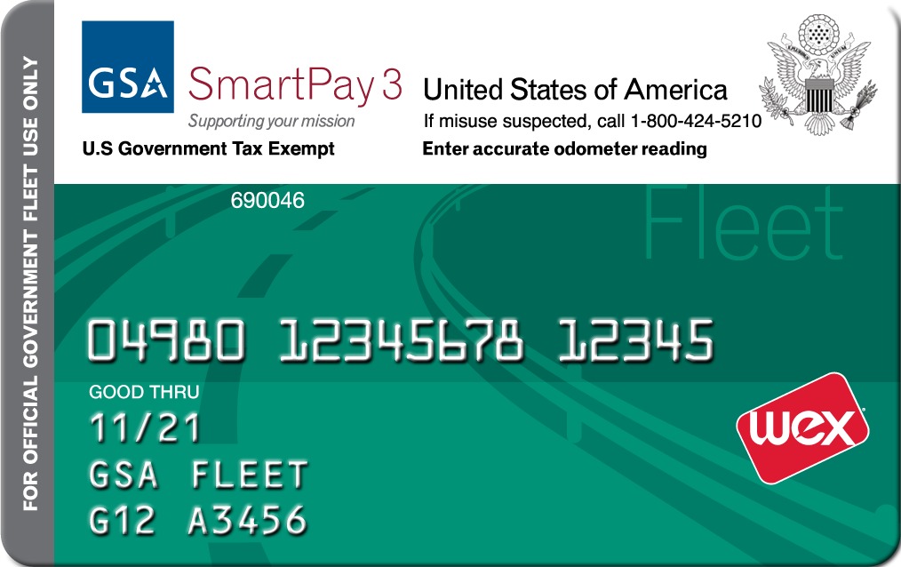
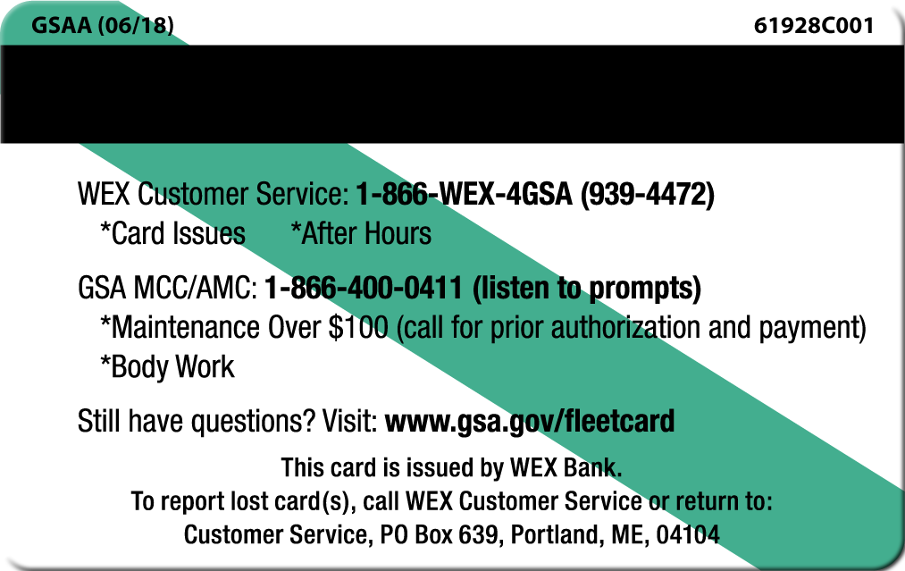
Everything You Need to Know
One card per vehicle/ One driver ID per card
Enter correct odometer readings
Tax exempt reminds vendors
Letter may be at the end or in the middle of the tag
Service for fueling issues and repairs under $100
GSA MCC/AMC for repairs or accident approvals over $100
Notes:
Odometer entry is still important, even though the vehicle has telematics.

Slide 7
Fuel and Service Anywhere With WEX
500,000+
Additional fuel/maintenance locations with WEXPay™, a virtual MasterCard
160,000+
Fueling locations in 95% of retail sites
80,000+
Diesel sites
45,000+
Maintenance locations with WEX swipe
3,300+
Canadian retail fuel sites

Slide 8
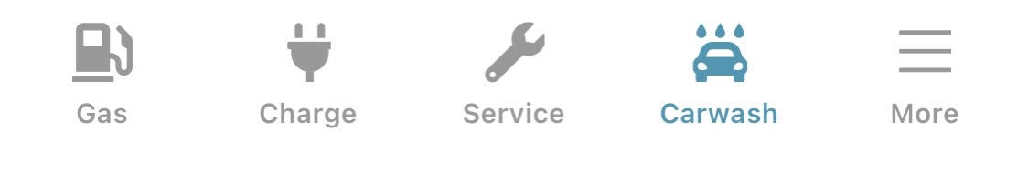
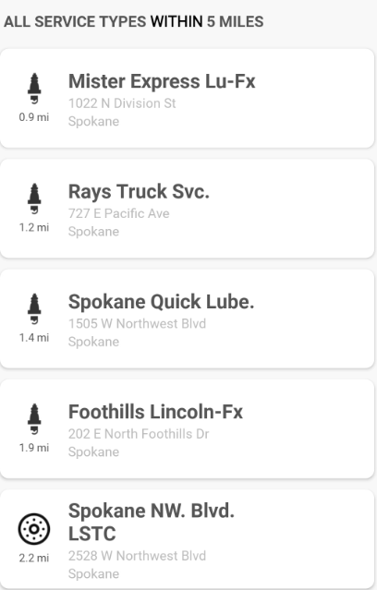
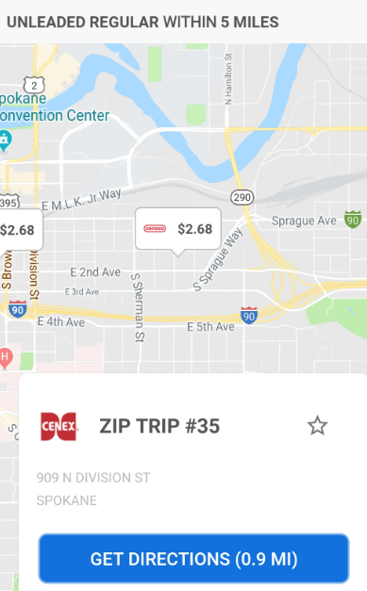
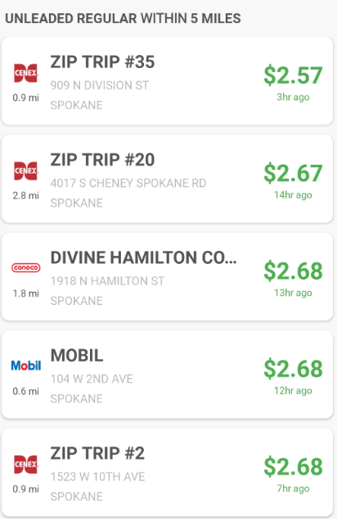
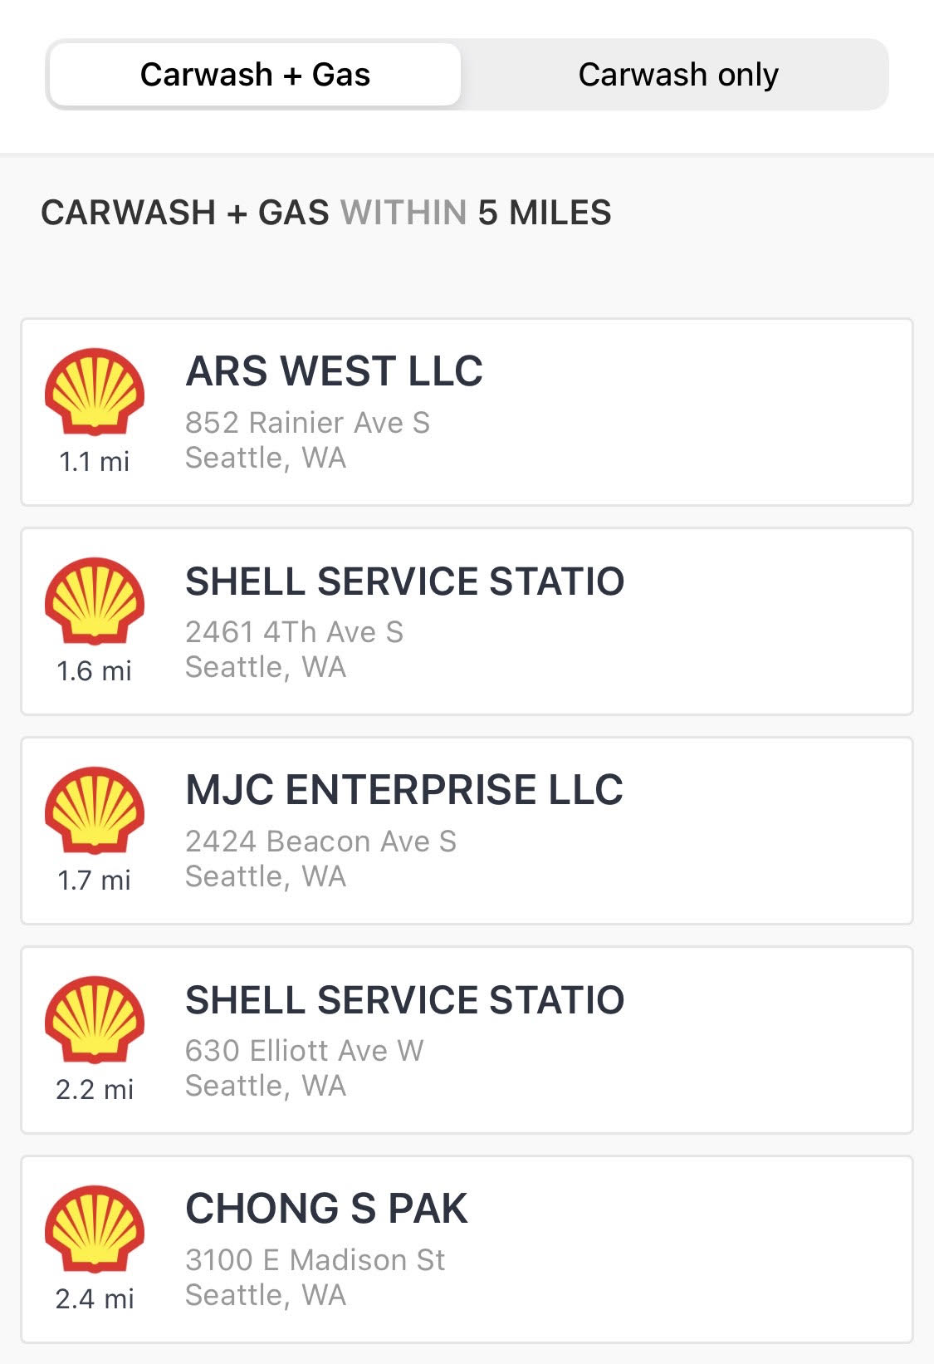
WEXConnect App® - (Google Play® & iOS Apps®)

Slide 9
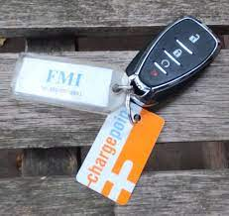
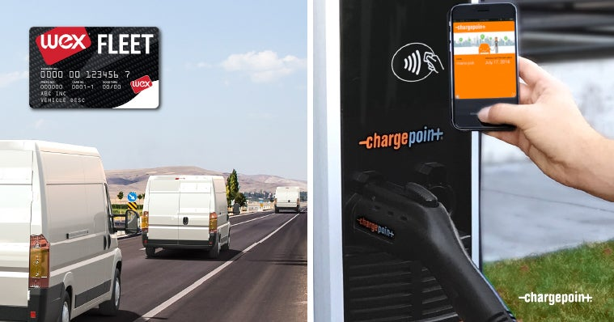
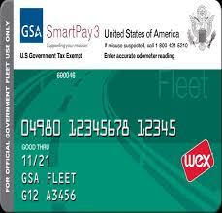

Electric Vehicle Fueling Experience Considerations
In general, the market is in the early stages and still evolving
“Fueling experience” is different from traditional ICE (internal combustion engine) vehicles
Management of “mixed fleets” for many years
Evolution of the payment/charging experience
WEX and ChargePoint are connected

Slide 10
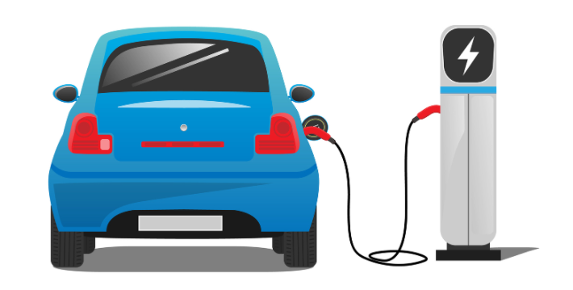
Paying for EVs: What to Know
Charging:
use RFID card to charge at ChargePoint chargers in your operating area
use free chargers around town
use onsite charging
Maintenance:
use the WEX card for vehicle incidentals and routine maintenance under $100 like wiper blades, etc.
the vendor can call the MCC or use Auto Integrate for vehicle maintenance over $100

Slide 11

How to Charge at Public Stations
Request WEX-connected ChargePoint RFID card through FSR
Charge at multiple stations (~50% of public L2 stations will accept ChargePoint RFID) including the following networks:
Notes:
Should we direct customer to GSAFleetAFVTeam@gsa.gov or to their FSR?

Slide 12
Benefits of Fleet Branded Cards
Custom Card Controls
Driver ID
Level III Data Capture
Virtual Mastercard Platform

Slide 13
Fleet Cards Save Agencies Money
Fuel tax recovery of $12 million annually
Fleet card rebates of $7 million annually
Card controls limit purchases to approved products
Discounts honored by major service providers
Ensure expenses not included in your lease are billed to the correct agencies
Notes:
Fuel tax recovery of $12 million annually
-Billed net of taxes - captured at the pump at time of sale
-Billed net of taxes - fleet card provider recoups
-Fuel taxes recaptured by GSA directly with states

Slide 14

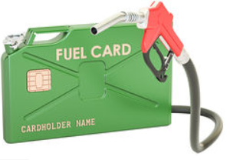
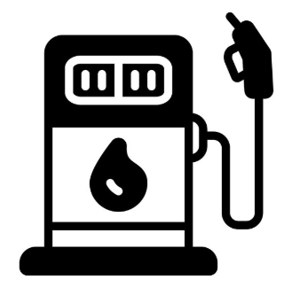
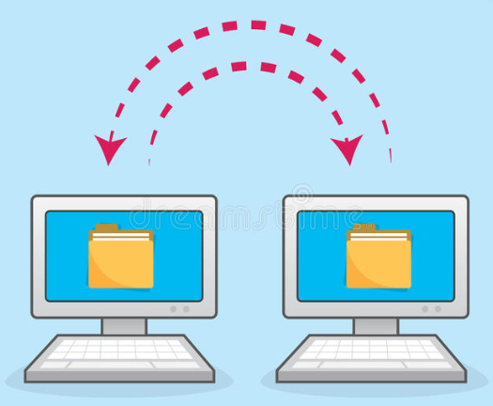
The Mystery of Product Coding
Pump or Register
Processor
1
2
3
4
Merchant
bank
Fleet card
There are various opportunities for things to go wrong.

Slide 15
The Dos and Don’ts
Authorized Purchases
Unauthorized Purchases
Use fleet charge card matching the license plate of the vehicle you are driving
Use the wrong vehicle’s fleet card or agency issued purchase card for a GSA Fleet leased asset
Regular unleaded, self-service fuel for GSA vehicle – alternative fuels as required
Premium or full service fueling (unless required by state law)
Immediately consumable items for vehicle (e.g. quart of oil, washer fluid, wipers)
Maps, air fresheners, food, lottery tickets, alcohol, etc.
Exterior Car Washes within local guidance
Excessive car washes or details
Mechanical repairs for assigned GSA vehicle
Upgrade tires or accessories such as snow plows without prior approval from FSR

Slide 16
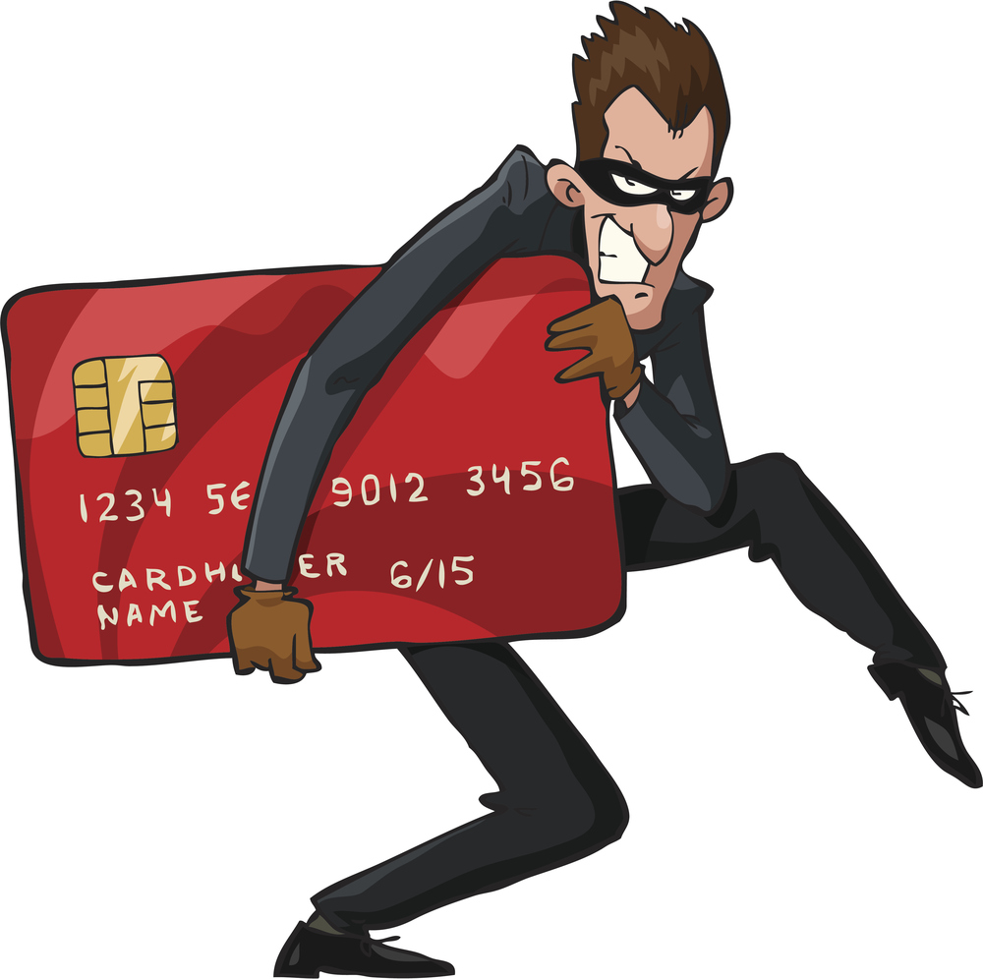
The Fleet Card Hustle
“Friends and family”
Lost or stolen cards
Skimming
Phishing

Slide 17
Is This Fraud or Misuse?
Day of Week | Date | Time | Time Diff | Odometer | Tank Size | Units | Merch Brand
TUESDAY | 11/19/2022 | 19:12 |  | 22,273 | 50 | 15.6 | SUNOCO
TUESDAY | 11/19/2022 | 19:14 | 0:02 | 19,391 | 50 | 13.4 | SUNOCO
TUESDAY | 11/19/2022 | 19:19 | 0:05 | 49,859 | 50 | 7.6 | SUNOCO
TUESDAY | 11/19/2022 | 19:22 | 0:03 | 22,500 | 50 | 14.8 | SUNOCO
TUESDAY | 11/19/2022 | 19:26 | 0:04 | 22,500 | 50 | 17.5 | SUNOCO
TUESDAY | 11/19/2022 | 19:29 | 0:03 | 22,500 | 50 | 27.4 | SUNOCO
WEDNESDAY | 11/20/2022 | 11:53 |  | 22,500 | 50 | 18.1 | 7-ELEVEN
WEDNESDAY | 11/20/2022 | 11:55 | 0:02 | 25,469 | 50 | 17.6 | 7-ELEVEN
WEDNESDAY | 11/20/2022 | 12:00 | 0:05 | 22,500 | 50 | 18.9 | 7-ELEVEN
WEDNESDAY | 11/20/2022 | 12:03 | 0:03 | 20,616 | 50 | 20.7 | 7-ELEVEN
WEDNESDAY | 11/20/2022 | 12:07 | 0:04 | 0 | 50 | 16.8 | 7-ELEVEN
WEDNESDAY | 11/20/2022 | 12:10 | 0:03 | 50,039 | 50 | 15.6 | 7-ELEVEN
Amount of gas pumped exceeds the tank capacity
12 transactions inside 24 hours
Odometers all over the place

Slide 18
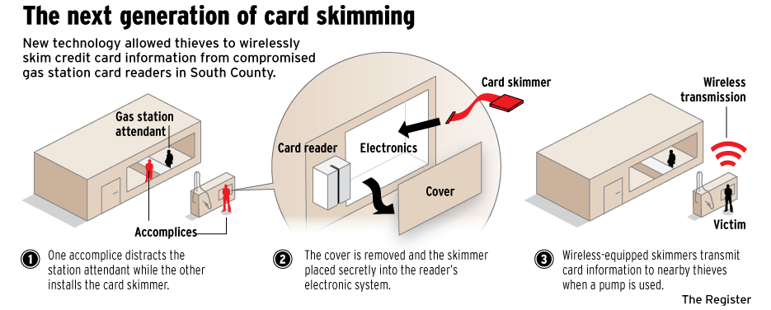
All About Card Skimmers
What can you do to avoid getting skimmed?

Slide 19
Protecting Your Fleet Cards
Agencies shall ensure accountability – know who had card and when
One card per vehicle – use the correct one
Keep your Driver ID/PIN confidential - do not write on/near the card
Secure cards when stored – don’t leave in vehicles or in places accessible to all – two lock system

Slide 20
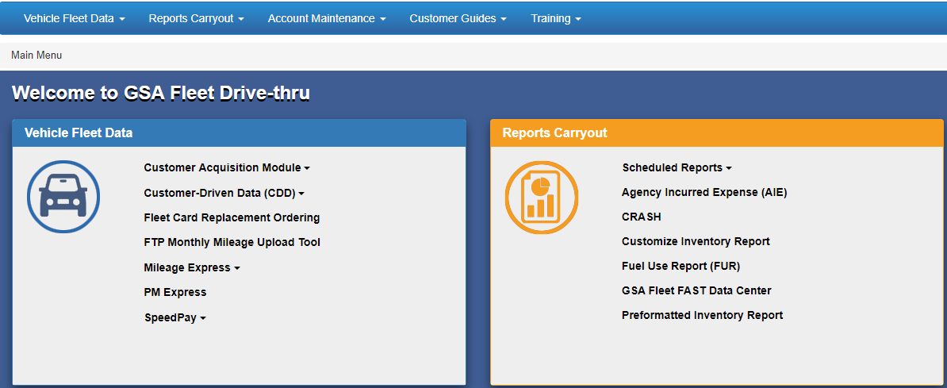
Everything Else You Need to Know
Driver Training
Card Ordering
Transaction Data

Slide 21
Ordering a Replacement Fleet Card
Fill in the request details. Select default address or type in a field location.
Receive replacement card and begin using immediately.
Register and log in to Drivethru.
1
3
5
2
4
Select
“Fleet Card Replacement Ordering.”
Cards ordered prior to 1:00pm EST should be received the next day via UPS, depending on location.

Slide 22
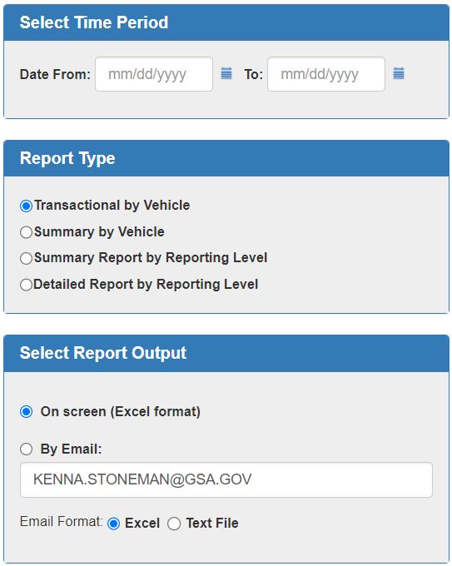
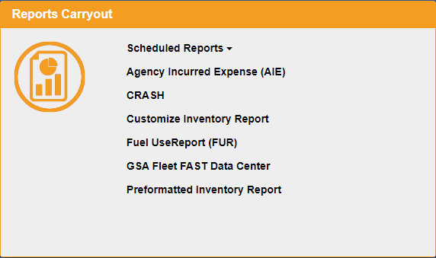
Fuel Use Reports in GSA Fleet Drive-thru
Fuel Summary and Detailed Transaction Reports Available

Slide 23
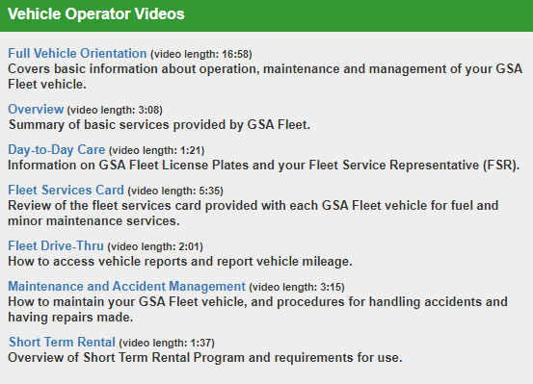
GSA Fleet Drive-thru Training
Fleet Card
Driver Training

Slide 24

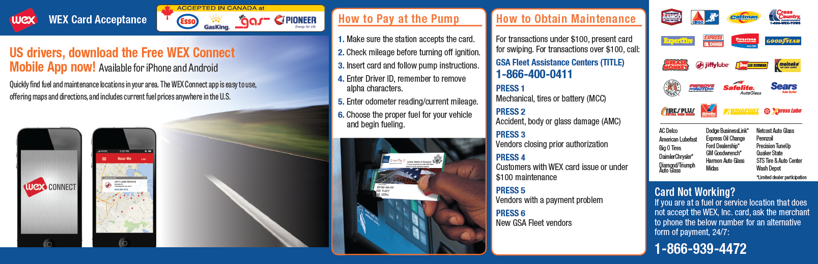
When in Doubt, Consult the Directions

Slide 25
Contact Us
Loss Prevention Team - LPT@gsa.gov
Replacement Cards - replacementcards@gsa.gov
www.gsa.gov/fleetcard
Presenters:
brian.moseley@gsa.gov
kenna.stoneman@gsa.gov

Slide 26

GSA Starmark Logo

